Slide 1

Project summary - Cross/Up Sell Model
The project is defined as 9 tasks. Cross/Up Sell model is a predictive model to predict customer’s additional contract from various factors.
Project tasks
Overview of Cross/Up Sell model
Developing a model that calculates the possibility of additional contracts within the next six months by using the customer's demographic, contract and transaction history information for customers with valid contracts at the time of reference.
Cross/Up Sell model
Estimated items
Cross/Up Sell
model
FP Recruting model
Score
Demograp
$$f\left(x\right)$$
Customer churn model
Cx
99.9
Contract
Activity Interrupt Prediction Model
Payment
New Contract Retention Rate model
Touch
Pattern learning
OptimalFP Selection
Contract
Lost
FP information
Income estimation model
…
Customer network model
Historical theory
FP coaching model
→ Score is calculated monthly

Slide 2
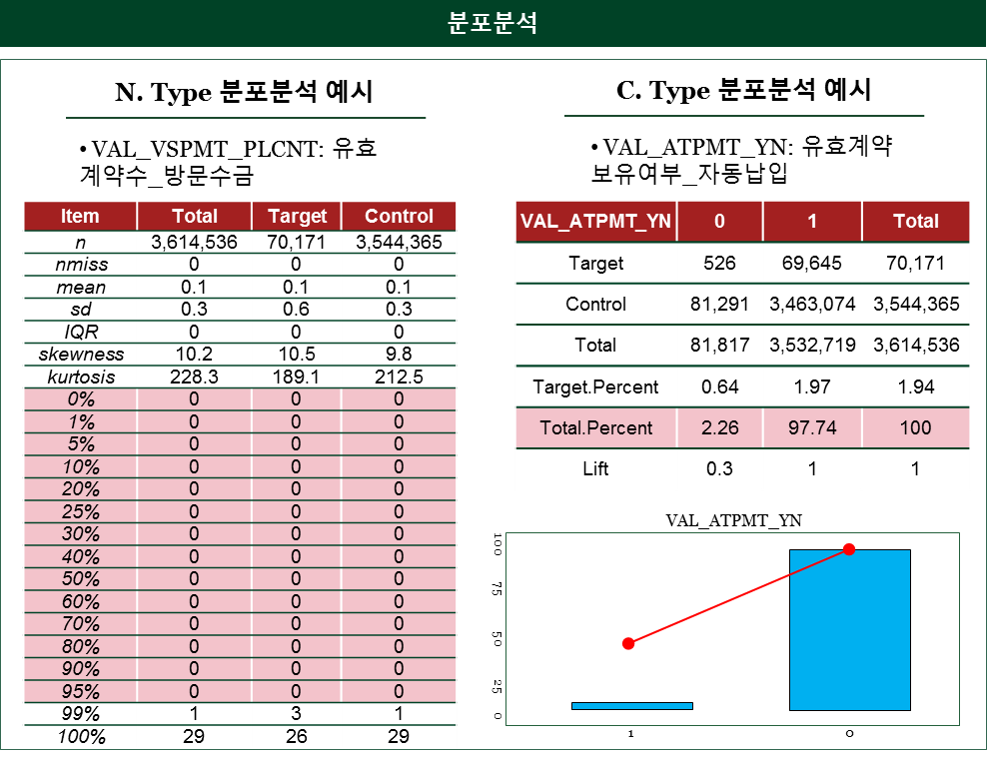
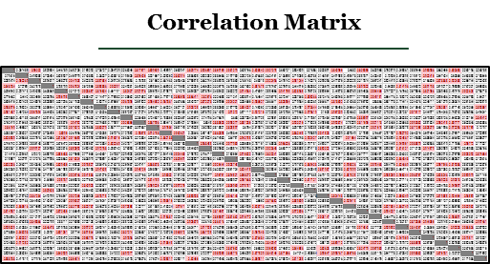
Overview of model development
Analytical model development has produced a highly discriminative model for target by applying various modeling techniques to various candidate variables
Overview of model development
Using the candidate variables to create a highly discriminative model for the target through a combination of variables and modeling techniques.
Target1
Contract for investment
Target2
Contract for claim
Variable selection
Selected variables
Model method
Model Assessment
Priority TOP N
Sampling
Logistic Regression
Significance test
Correlation analysis
Feature Selection
Decision Tree
Priority TOP N
+ Business 관점
Random Forest
195 Variables
+
Additional Parameter

Slide 3
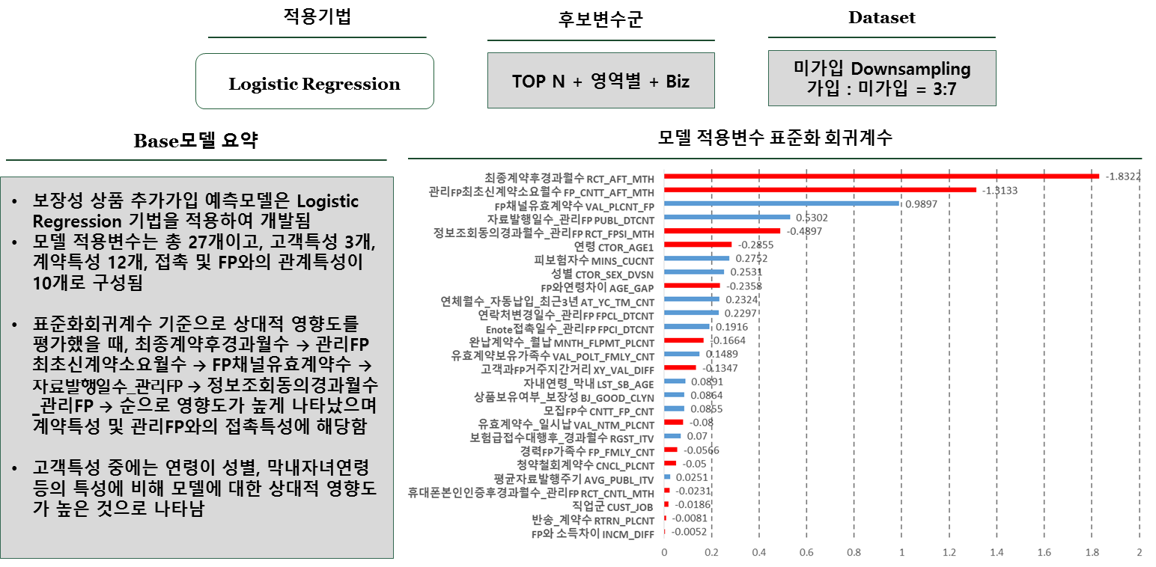
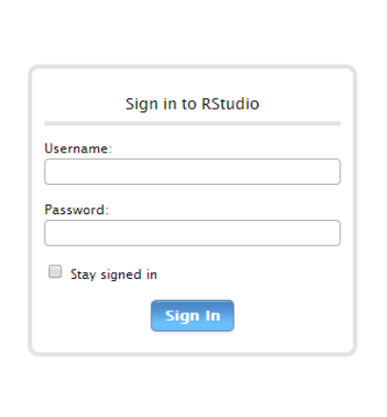
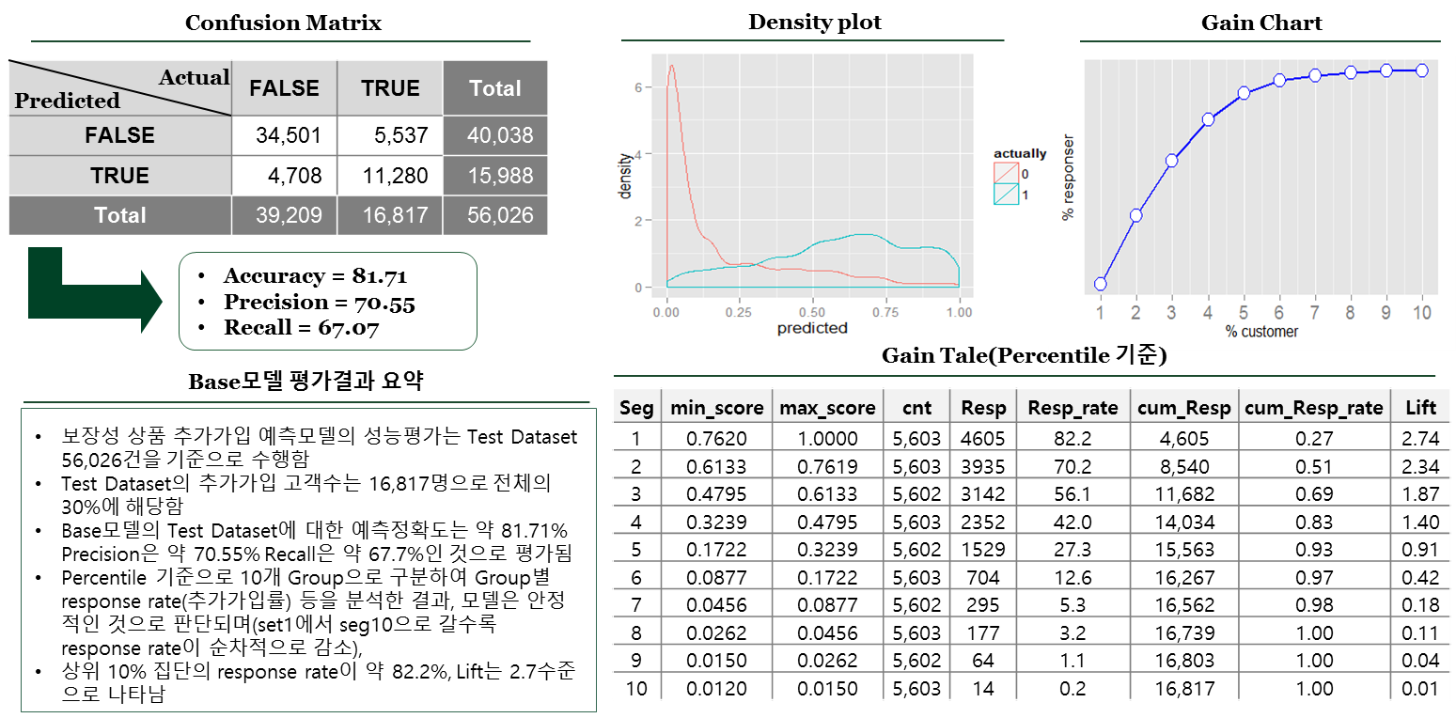

Assessment and application of the model
The analysed model was evaluated for Accuracy according to modeling application techniques, candidate group, and Sampling Data set, and the developed model was utilized through an R package linked to Oracle.
Assessment of the model
Application of the model
Model
Illustrative
1
2
Oracle Server
(Linux OS)
R studio
Web Server
Validation
3
4
$$f\left(x\right)$$
RODBC
RJDBC
ROracle
ORE
Model Object Created
Used Oracle interlinked package (ORE)

